Slide 1

Special Needs Plan Model of Care (SNP - MOC) 2025 Model of Care Training for Providers
Proprietary & Confidential

Slide 2
Learning Objectives
To gain an understanding and comprehension of CCHP's Special Needs Plans (SNPs)
To gain an understanding and comprehension of the Elements of the SNP Model of Care
At the end of this training, you will be able to:
Describe the best practices for the SNP Model of Care
Describe how to improve coordination of care and member health outcomes

Slide 3
PROVIDER TRAINING STANDARDS
Chapter 42 of the Code of Federal Regulations, Part 422 (42 CFR 422.101 (f)(2)(ii)) mandates that Special Needs Plans (SNP) conduct SNP Model of Care (MOC) training for all employed and contracted providers.
All CCHP participating providers who routinely sees CCHP Medicare SNP members must receive training on the MOC initially and annually thereafter.
Initial training must be completed within 90 days from contract execution date and annually thereafter.
Annual training is provided via live webinar and attestation statement must be completed within 90 days from the live webinar.

Slide 4
What is SNP Model of Care?
Special Needs Plans are specialized Medicare Advantage plans for beneficiary with special circumstances. A SNP can be one of 3 types:
Chronic SNP (C-SNP) for members with severe or disabling chronic conditions.
Institutional SNP (I-SNP) for members requiring an institutional level of care or equivalent living in the community.
Dual-Eligible SNP (D-SNP) for members eligible for Medicare and Medicaid.
Model of Care is a comprehensive plan for delivering integrated care management program for special needs member.
It is the architecture for promoting quality, integrating benefits, coordination of care, and operation processes.

Slide 5
CCHP offers a Dual Eligible SNP (D-SNP)
CCHP offers a D-SNP named “CCHP Senior Select Program (HMO SNP)”
Enrollees must have Medicare and Medicaid benefits
Offered in San Francisco
Enrollees in this D-SNP are responsible for $0 for covered medical services

Slide 6
D-SNP Benefits at CCHP
CCHP offers specific benefits plans that meet the unique needs of our population which may include:
Walk in services at our Member Services
Medication Therapy Management
Disease management services
Non-emergency transportation services
Holistic and complementary health services
Community partnerships – Chinese Community Health Resource Center (CCHRC)
Over-the-counter allowance
Flex card benefits

Slide 7
D-SNP Model of Care
Written documentation that describes the care management process and operations
Required by Centers for Medicare and Medicaid Services (CMS)
Must be NCQA accredited and renewal depends on scoring, ranges from every one (1) to three (3) years
CCHP received three (3) years approval in 2022
There are four (4) Model of Care Domains and fifteen (15) Elements

Slide 8
SNP MOC: 4 Domains, 15 Elements
DOMAIN 1: Description of the SNP Population
Element A. Description of Overall SNP Population
Element B. Sub-Population: Most Vulnerable Beneficiaries
DOMAIN 2: Care Coordination
Element A. SNP Staff Structure
Element B. Health Risk Assessment Tool
Element C. Face-to-Face Encounter (F2F)
Element D. Individualized Care Plan (ICP)
Element E. Interdisciplinary Care Team (ICT)
Element F. Care Transitions Protocols

Slide 9
SNP MOC: 4 Domains, 15 Elements (cont.)
DOMAIN 3: SNP Provider Network
Element A. Specialized Expertise
Element B. Use of Clinical Practice Guidelines and Care Transition Protocols
Element C. MOC Training for the Provider Network
DOMAIN 4: Quality Measurement / Performance Improvement
Element A. MOC Quality Performance Improvement Plan
Element B. Measurable Goals and Health Outcomes for the MOC
Element C. Measuring Patience Experience of Care (Satisfaction)
Element D. Ongoing Performance Improvement Evaluation of the MOC
Element E. Dissemination of SNP Quality Performance Related to the MOC

Slide 10
SNP MOC responds to our mission
Provide high-quality, affordable healthcare through culturally competent and linguistically appropriate services
CCHP provides services to:
Frail elderly
High health risk individuals
Low-income and low socioeconomic population
Individuals with multiple chronic and acute health problems
Individuals with or at risk of medication and treatment plan non compliance
Individuals that lack family support
Limited English literacy individuals
Individuals with barriers to access community resources and support
Strive for quality outcomes
Support PCPs plan of care
Educate, guide, and support individuals to health and community resources

Slide 11
SNP MOC Goals
Improve access to care
Improve transitions of care to reduce unnecessary ED and hospital admissions
Improve coordination of care through a single point of contact
Improve access to preventive health services
Improve appropriate utilization of services
Improve quality scores
Improve member satisfaction with providers and the plan
Improve health outcomes

Slide 12
Description of the SNP Population
CCHP currently has 3,758 SNP beneficiaries in San Francisco.
97% of the SNP Population are Chinese
25-101+ years old is the age range of this population
65.7% of beneficiaries are between the ages of 65-80 years old
55.4% beneficiaries are women, 44.6% are men

Slide 13
What is Care Coordination?
Facilitates effective use of resources to reduce the overall cost of care with overall goal of improved health outcomes
Provides a single point of contact for the member across the continuum of care
Coordination staff include registered nurses, social workers, and non-clinical coordinators
Work collaboratively with the member, family/significant others, and providers of health care to implement a plan of care which meets the individual’s needs

Slide 14
What are Care Coordination Activities?
Performs an assessment to identify individual health needs
Develops a comprehensive individualized care plan (ICP)
Identifies barriers to goals and strategies to address
Provides personalized education for optimal wellness
Encourages preventive care
Post Discharge planning
Reviews and educates on medication regimen
Assists member to access community resources, Medicare, Medicaid benefits
Assists caregiver when member is unable to participate

Slide 15
Health Risk Assessment
CMS regulation requires a Health Risk Assessment (HRA) is conducted for each member enrolled in SNP
CCHP administers a health risk assessment (HRA) to all SNP members.
Self-reported survey includes questions on medical, psychosocial, cognitive, functional and mental health.
Consistent with CMS HRA regulation, CCHP updated HRA in 2024 to include questions regarding housing stability, food security, and access to transportation.
Initial HRA sent upon effective enrollment.
Annual reassessment sent upon 365 days of last HRA.
Telephonic outreach is conducted if no HRA is returned within 1 month of mailing date.
HRA provides the basis for the development of the plan of care.
Care Coordinators will review HRA and may contact member for follow up.

Slide 16
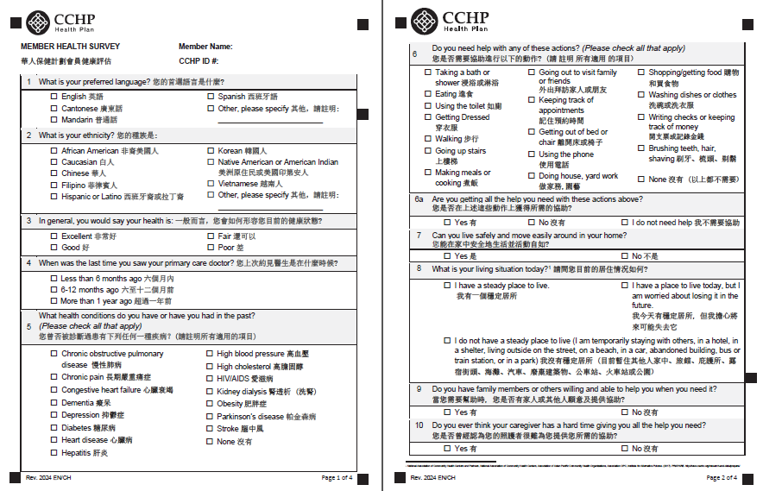
HRA Sample

Slide 17
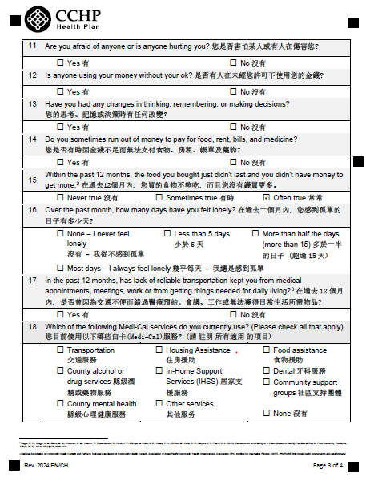
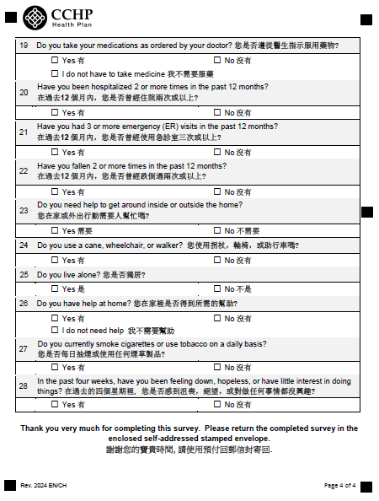
HRA Sample

Slide 18
Face-to-Face Encounter
CMS regulation requires require that all SNPs must provide for face-to-face encounters for the delivery of health care, care management or care coordination services as feasible on at least an annual basis
The Care Coordination team may engage with the member in-person where possible and feasible and/or collaborate with a provider for the in-person contact such as a contracted home health, case manager, facility/office provider, community health worker
May work with various providers or entities to coordinate the member’s needs
When in-person engagement is not available or appropriate such as when the member refuses, CCHP may utilize alternative communication methods such as telemedicine platforms, telephonic outreach, or mail to supplement the member contact

Slide 19
Development of Individualized Care Plans (ICP)
CMS regulation requires an individualized care plan (ICP) is developed for each member enrolled in SNP
HRA responses used to develop/update the ICP
Data such as claims and labs is used to develop the member’s ICP when no HRA response is received
ICP is maintained and stored to assure access by all care providers and meet HIPAA and professional standards
ICP may include the following:
Member’s health care preferences
Goals and objectives and targets with detailed tasks and self-management plans
Interventions and services tailored to member’s unique and individual needs
Documentation if time-bound goals met or not met
Utilize evidence-based guidelines such as InterQual Care Guidelines

Slide 20
Individualized Care Plan Goals Model
ICP goals based on the SMART Measurable Goal Model:
Specific – Exactly what is to be learned/accomplished by the member.
Measurable – A quantifiable goal and specific result that can be captured reported and documented in the ICP.
Attainable – Goal is achievable by the member.
Relevant – Goal is clearly linked to health status.
Time-Bound – The deadline or time period to motivate and evaluate is specific in terms of specific date, number of days/weeks/months or calendar year.

Slide 21
Individualized Care Plan…cont.
ICP developed addresses HRA responses and member preventive care gaps.
Members that do not respond to the HRA will receive an ICP based in part of claims or encounter data.
ICP is documented in the care management tool and updated when a member’s health status changes or at minimum annually.
ICP updates and changes are communicated to the member, caregiver(s) and provider(s).

Slide 22
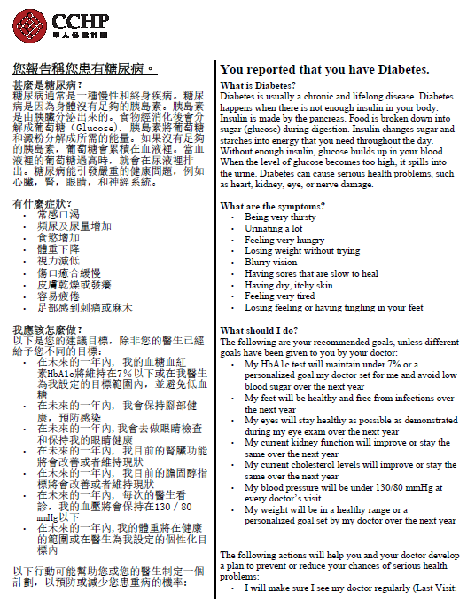
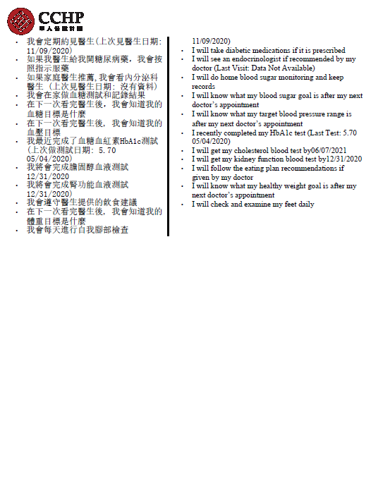
ICP Sample

Slide 23
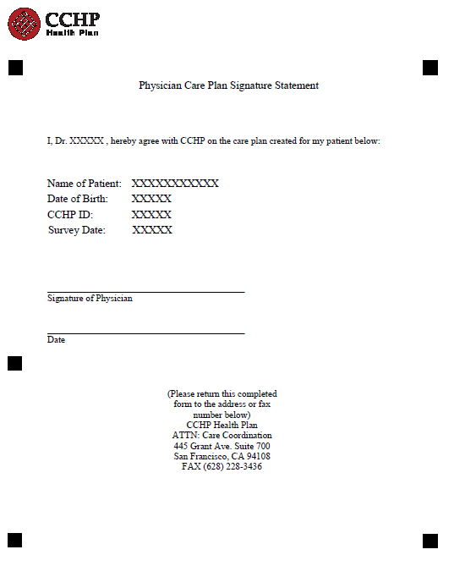
ICP Distribution
ICP are communicated via mail, fax, and secure email.
Providers are asked to sign and return the Physician Care Plan Signature Statement to Care Coordination department.

Slide 24
Interdisciplinary Care Team (ICT) and Staffing
Participants of the ICT may include, but not limited to:
Member/ Designated representative. Provides input on health care preferences and plan of care.
Primary Care Provider. Acts as the member’s gatekeeper. Works closely with the member to identify needs and ensure timely access to quality care.
Chief Medical Officer. Responsible for administrative performance compliance and care delivery services to ensure high quality of care for all beneficiaries
Care Coordination Manager. Oversees the day to day operations of the care coordination team.
Care Coordination Nurses. Contact communicate and coordinate care; post-discharge, disease and case management and health education.
Medical Social Workers. Address psychosocial issues access to low or no cost community resources, housing programs, appointments with network and out of network providers.
MTM Pharmacist. Address medication issues or concerns and refer to MTM program for medication review if deemed eligible.

Slide 25
Interdisciplinary Care Team (ICT)
ICT composition is determined by member’s needs.
Provider and member participation in the ICT can better help address member’s needs and achieve the plan of care.
ICT may provide input and evaluate member’s plan of care.
CCHP holds ICT meetings regularly with clinical staff.

Slide 26
Transition of Care
Care transitions occur when a member moves from one health care provider or setting to another; for example, member was admitted to hospital and discharge to home, acute rehab, or skilled nursing facility.
The member’s plan of care is updated in the event of a health status changes or care transition.
Primary care providers are notified when their patient has a transition of care.
Our clinical staff will assist members to ensure appropriate follow up care is arranged after a transition of care.

Slide 27
Network Providers
Incorporate relevant clinical information in the member’s plan of care
Follow transition of care protocols
Utilize evidence-based care guidelines
Annually review delegated group utilization decisions and member appeals process
Review patient medication profiles in Medication Therapy Management (MTM) Program
Contribute to improve the STAR and HEDIS outcomes reporting
Help improve member experience through CAHPS and HOS data collection
May participate in the Quality Improvement (QI) committee quarterly meeting

Slide 28
Role of the Provider
Plays an integral part of the care team
Encourage member to work with CCHP’s care coordination team
Take calls from the member’s Care Coordinator
Collaborate with the member’s Care Coordinator to address needs
Review the member’s plan of care and send back the care plan attestation
Participate in the ICT
Complete the annual MOC training

Slide 29
Hearing Aid/ Dental Benefits
Providers are encouraged to refer member to utilize their Hearing aid and dental benefit as part of their Medi-Cal benefit.
CCHP offers supplemental hearing aid benefit, as well as Medi-Cal covers hearing aids through the member’s Medi-Cal managed care plan (MCP).
Medi-Cal covers a variety of dental benefits, up to $1,800 a year for covered dental services
DHCS published a Hearing Aid fact sheet for providers for duals, available at: https://www.dhcs.ca.gov/individuals/Documents/Hearing-Benefits-Provider-Fact-Sheet.pdf
DHCS published a Hearing Aid fact sheet for providers for duals, available https://www.dhcs.ca.gov/services/Documents/Dental-Benefits-Provider-Fact-Sheet.pdf

Slide 30

Provider Dementia Care Aware Training
Per DHCS- MOC 3c Factor 1A- Providers are encourage to complete training on initial screening and comprehensive assessment for dementia.
The California Senate Bill 48 established an annual cognitive health assessment as a Medi-Cal benefit for beneficiaries age 65 and older if they are otherwise ineligible for a similar assessment as part of the Medicare Annual Wellness Visit.
Providers can receive payment for this Medi-Cal benefit if providers complete cognitive assessment training approved by DHCS using validated tools recommended by DHCS.
Dementia Care Aware training in the link below:
https://www.dementiacareaware.org/

Slide 31
MOC Measurement
CCHP measures the effectiveness of its MOC by utilizing standardized measures to monitor performance such as:
Healthcare Effectiveness Data and Information Set (HEDIS)
Utilization measures (Admissions, ER visits, Length of Stay)
Member experience (CAHPS, HOS surveys)
Member satisfaction with Care Coordination

Slide 32
Summary
CCHP SNP MOC needs to be YOUR model on managing care for your patients
The model supports the mission of CCHP and its business objectives
You are key to improving our members health outcomes

Slide 33
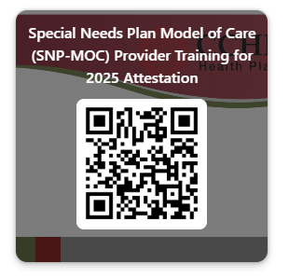
Training Attestation
To finalize completion of this training module, please click on the link below or scan the QR code to sign the attestation statement online.
I acknowledge that I have completed the 2025 D-SNP MOC Provider Training.
Link to the SNP-MOC Attestation: QR Code for the Attestation:
Form

Slide 34
Contacts and information
General Mailbox:
For Care Coordination needs:
Care.management@cchphealthplan.com
For Provider needs:
Provider.relations@cchphealthplan.com

Slide 35
References
Centers for Medicare and Medicaid (2014). Medicare Managed Care Manual - Chapter 5 (https://www.cms.gov/Regulations-and-Guidance/Guidance/Manuals/Downloads/mc86c05.pdf)
Centers for Medicare and Medicaid (2023). Medicare Managed Care Manual - Chapter 16B (https://www.cms.gov/files/document/r129mcm.pdf)
CMS Special Needs Plans (https://www.cms.gov/Medicare/Health-Plans/SpecialNeedsPlans)
CCHP SNP MOC
CCHP Policies and Procedures

Slide 36

THANK YOU

